Slide 1
Capstone Project
Group 12
April 17, 2023

Slide 2

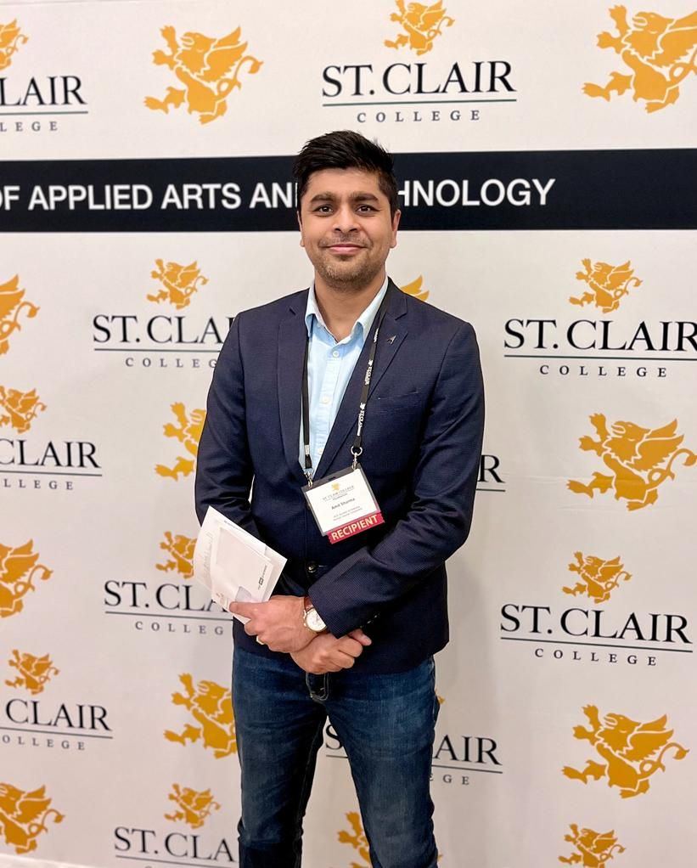




Team
Amit Sharma
Harshil Patel
Rajvi Mehta
Jayraj Radadiya
Suhail Ahmed

Slide 3
Agenda
01. Life of a Student
02. Problem statement
03. Solution
04. Technologies - Data flow
05. Demo
06. Wins, Struggles and Way-outs
07. What’s Next

Slide 4

Life of a Student
Achieving an optimal college experience is a common goal among all students. There are certain factors (with varying degrees of impact) that contribute to a desirable college experience like:
Personal and professional background, residential life experience, living flexibility, other academic factors
Factors, such as socioeconomic status, race, and ethnicity, may also play a significant role in shaping one's college experience.
The overall college experience can also be influenced by campus culture, extracurricular events, services provided and social opportunities.

Slide 5
Problem Statement
The purpose of this study is to examine the relationship between various factors and the day to day college experience for students. Specifically, the study will focus on
Demographics
Work history
Living conditions
to determine their impact on college experience and overall quality of life. By identifying patterns and correlations, the study results will provide insights that could be used to improve the academic experience.
Hypothesis
Students who have stable work histories, relatable educational backgrounds, and better living situations are more likely to have a positive college experience
Target population
DAB program Students

Slide 6

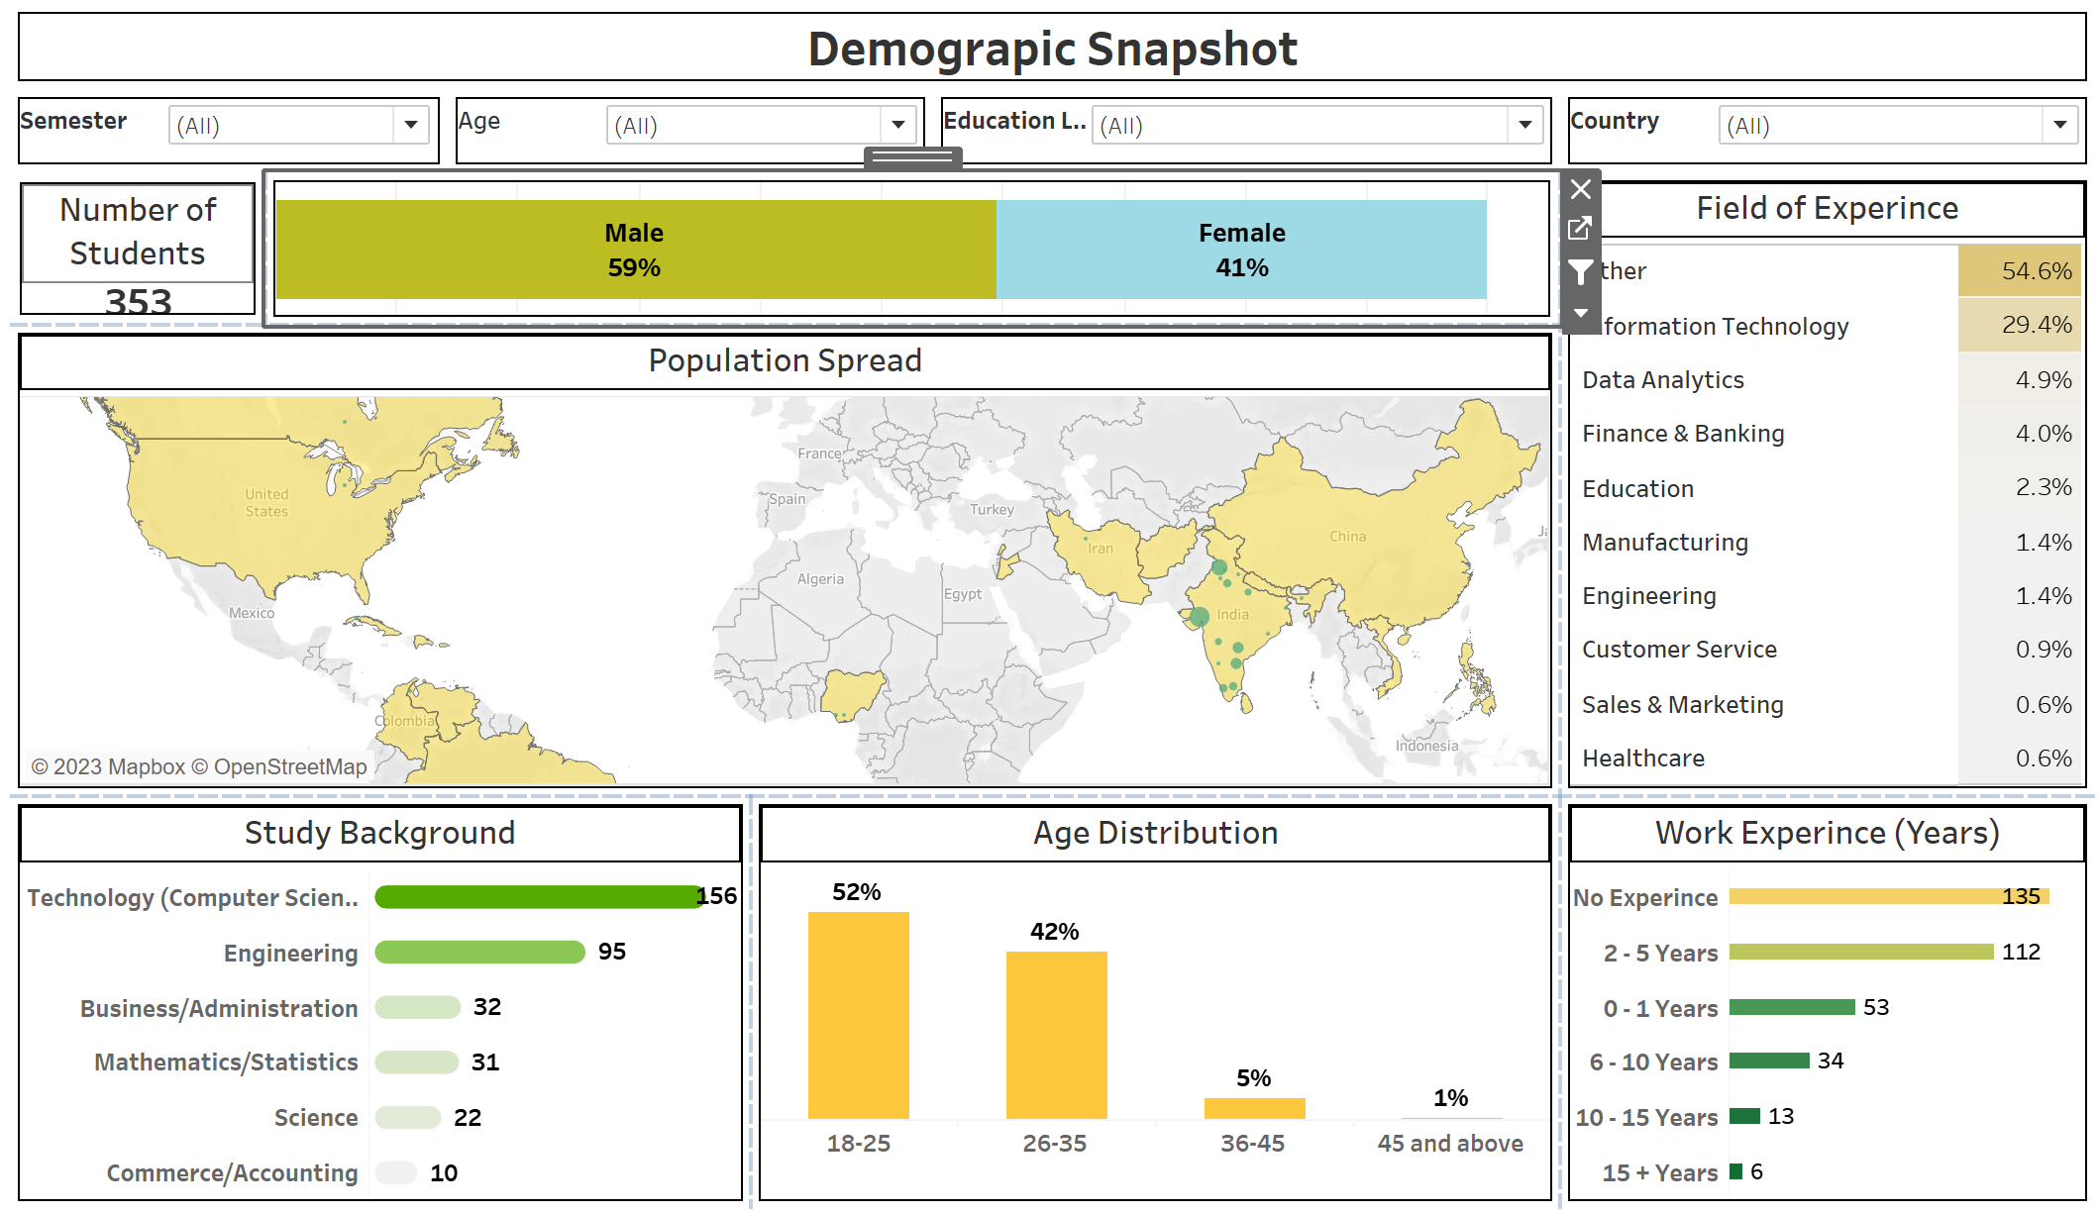
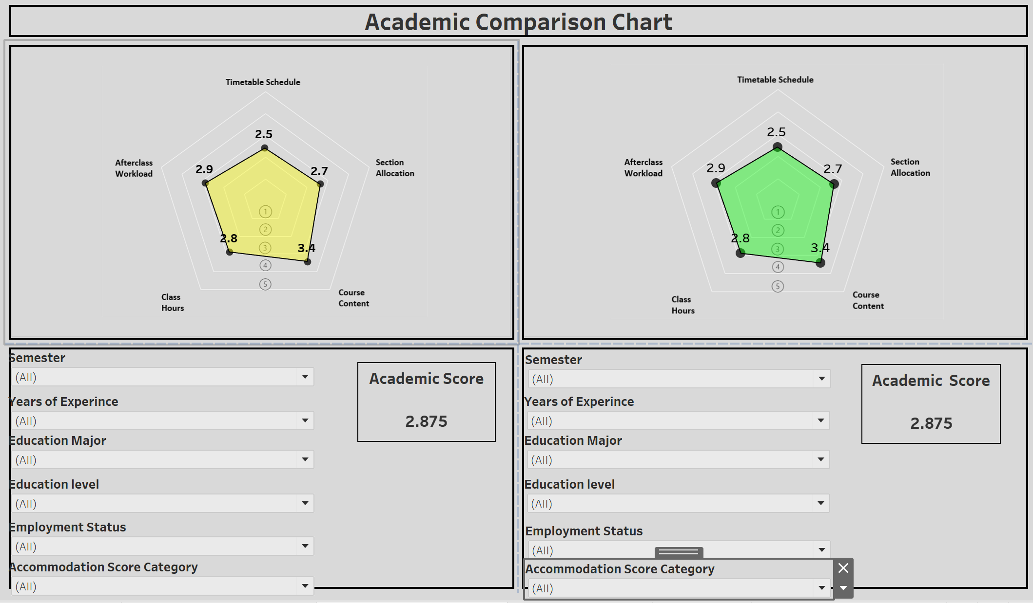
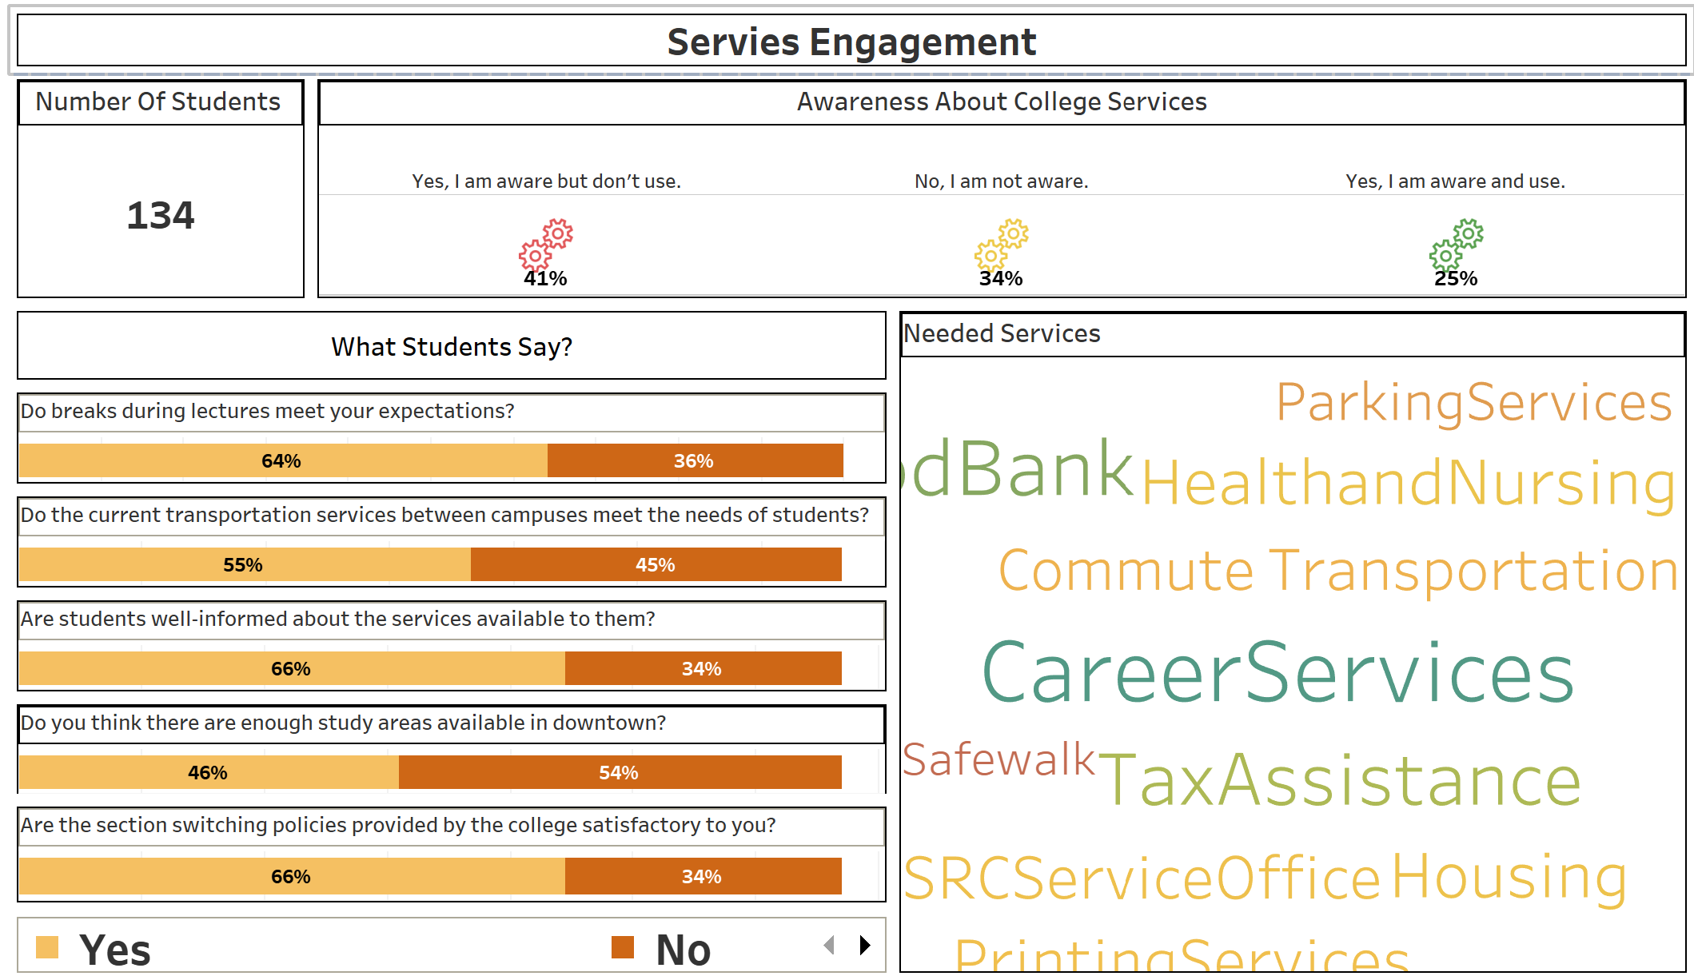
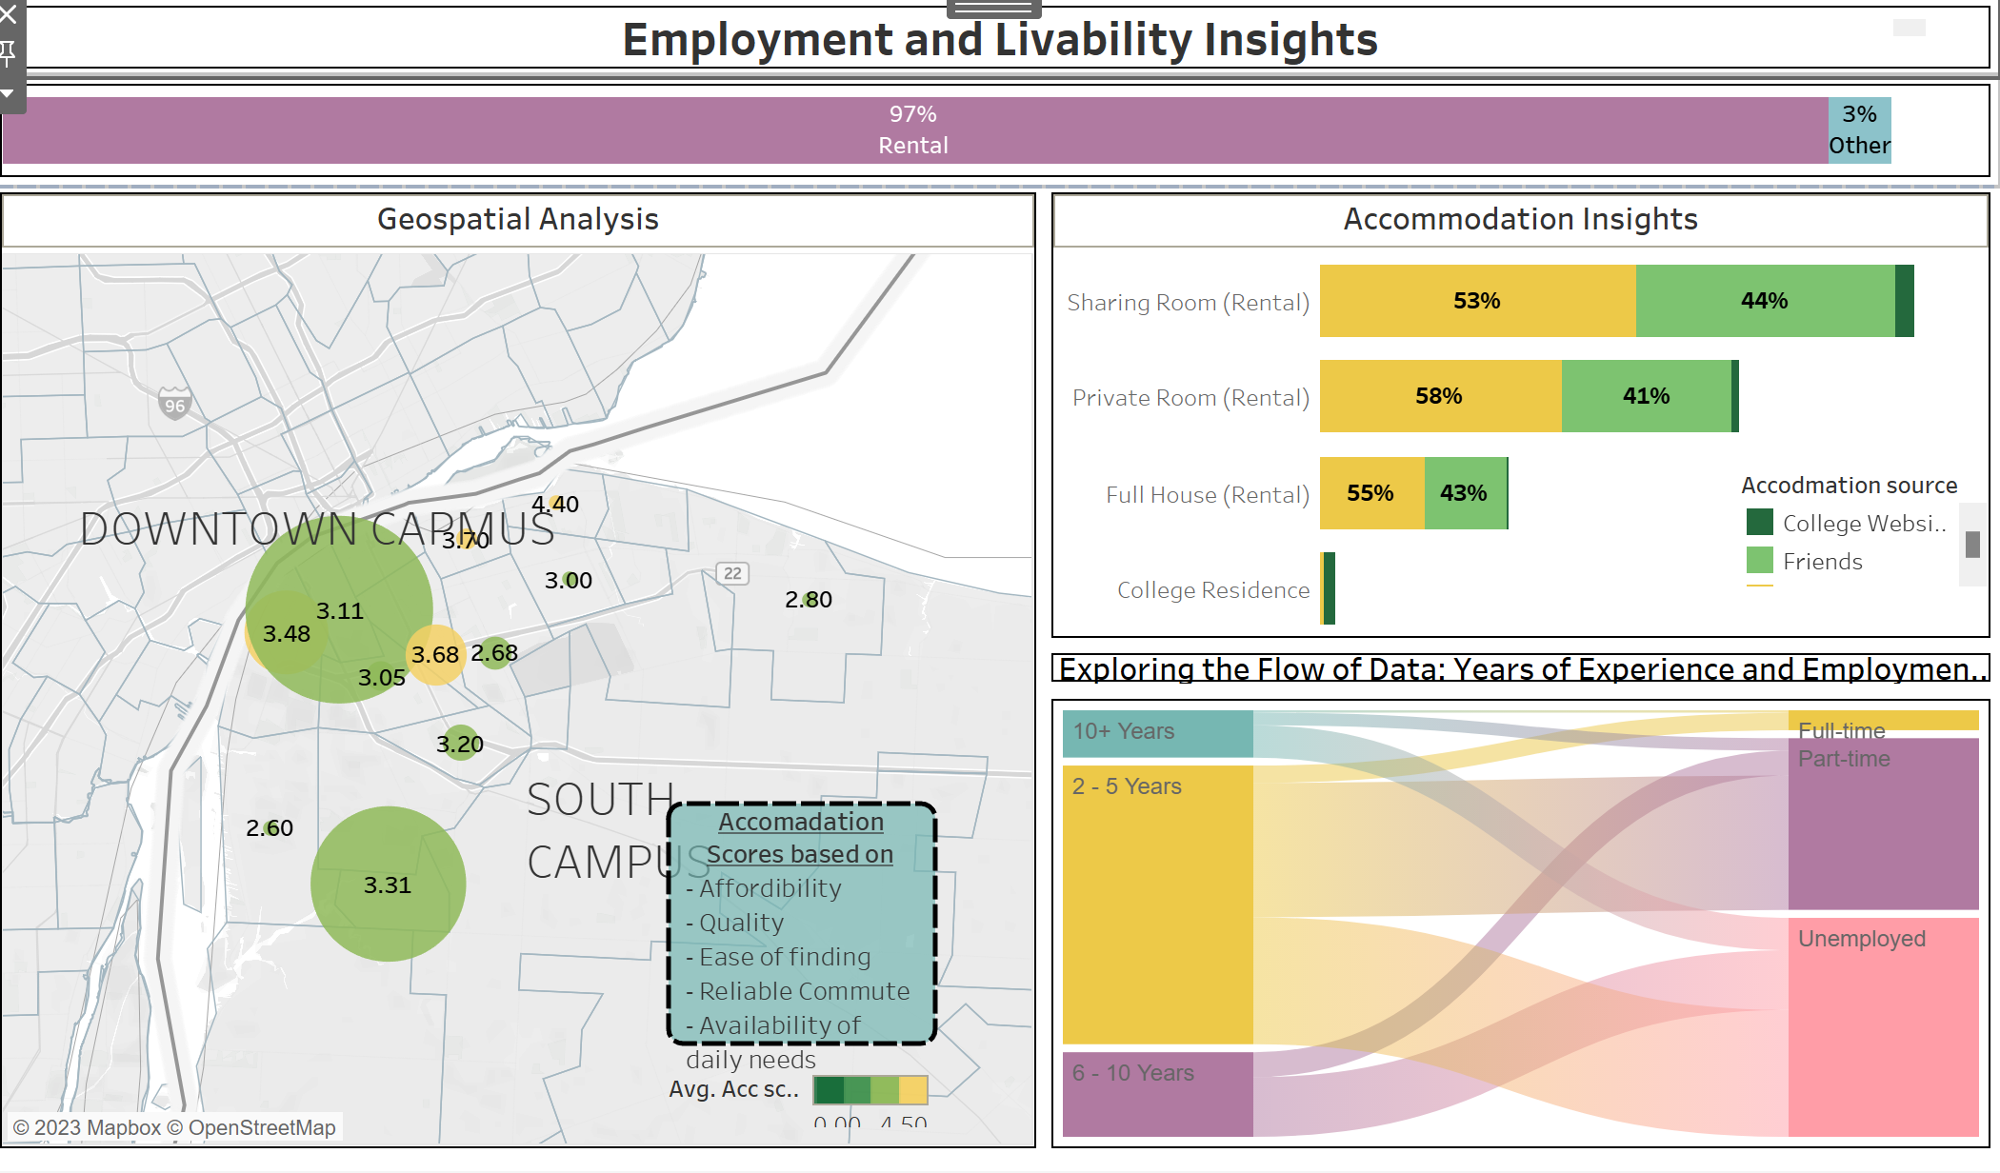
Solution
Central objective: To devise an automated and self-sufficient system that can proficiently showcase the correlations between diverse factors and a student’s college experience, while also forecasting the influence and potency of these factors on the same.
The solution's scope extends beyond providing insights solely on college experience, as it also aims to illuminate Student-College relationship. The implementation of this solution will ultimately enhance the experience for students.
Solution in Nutshell: Series of interactive Tableau dashboards that provide a detailed overview of the data journey, from initial background information to college outcomes and predictive analysis
Target User
College Management

Slide 7

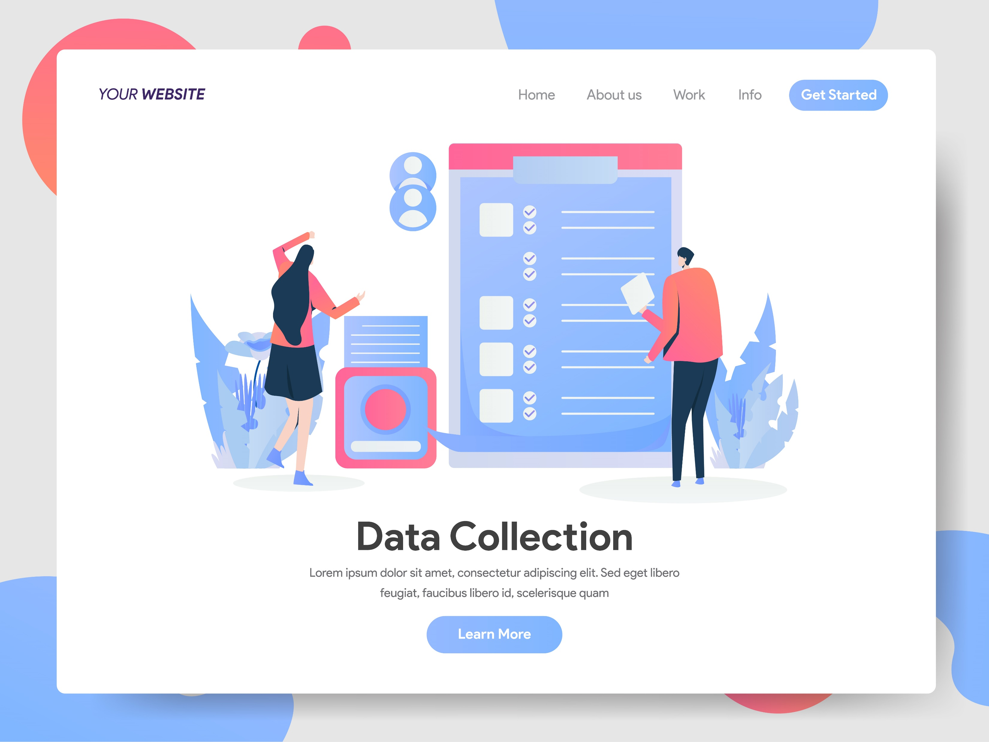
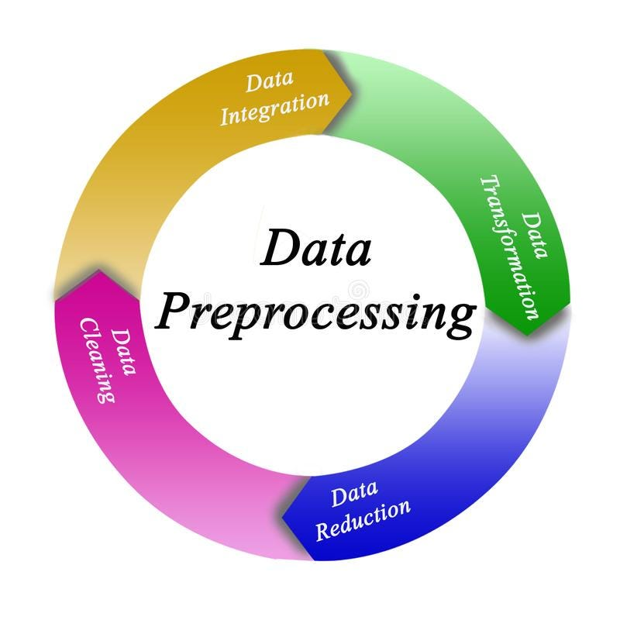

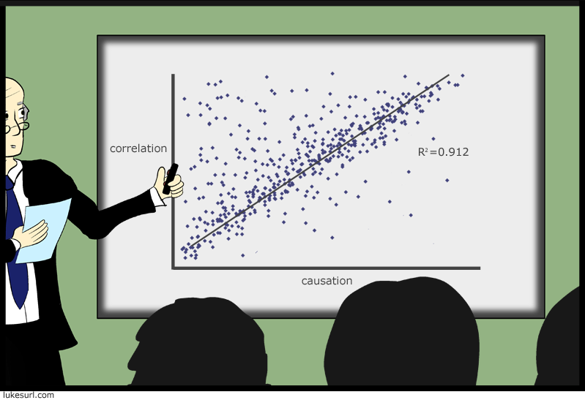






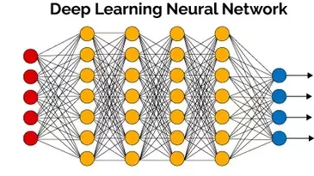


Data flow - Technologies
Link
Collection
Pre-processing
Transformation
Predictions
Presentation
Data Flow
Technologies
Method
2 surveys (Google and MS forms)
one at the start and one at the middle of the March
The center phase for Data work took most of the time involving Storage, DB architecture, Cloud connect and EDA for the data.
Predictions are based on FFNN and some Sentimental analysis
Story based Dashboards flowing the descripting and predictive analysis
Timeline
Business Problem Formulation
Data Collection
Data work
Data Pipeline/DB
Machine Learning
Dashboard Work
Data Work & Pipeline Integration
January2023
February 2023
March 2023
April 2023

Slide 8
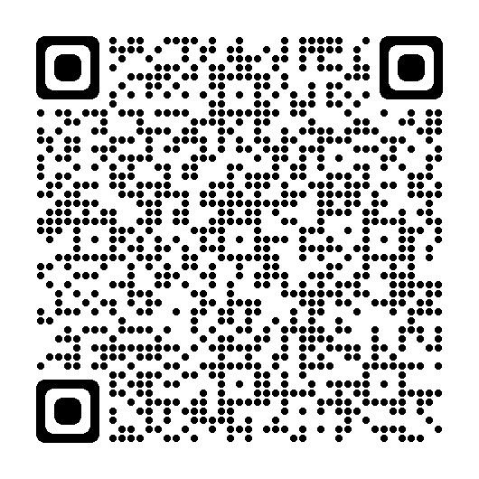
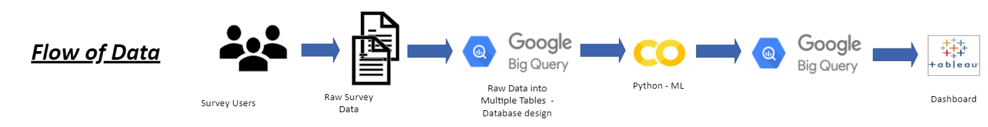
Demo
Part 1 - Dashboard
Part 2- Pipeline
Demographics
Windsor Story
Playground
Services and Inputs
Predictions

Slide 9
Wins, Struggles and Way-outs
Wins
Struggles
Way-Outs
Automated Cloud Data Pipeline
Hypothesis – Product connect
No PII Data
API angle
Multiple personal Learnings
No Cost involved
Data Collection & Population size
Multi platform integration
Time window
Non-linear data
Finding correlation and data connect
APIs
Setting Data boundaries
Setting Weights and Rules

Slide 10
What’s Next
Business/Domain
Technical
Expansion to more programs
Central DB for DAB program
Entry and Exit Survey
Focused intake process
Technical cloud pipelines
File arrive automation with email
Expand Sentimental analysis
Expand Predictive capabilities with ML/Deep learning

Slide 11

Thank you
Students – for Data
Mentors/Stakeholders – for the guidance
All college professors – for all the 4 sems of learnings

